Slide 1

Institute of Aeronautical Engineering.
Dundigal-Hyderabad
VI-Semester
Computer Science and Engineering.
ExEEd- Research Based Learning.

Slide 2
File Encryption System
S. No. | Name | Roll No. | Branch & Sec
1. | Vishweshwar Bitla | 20951A05Q0 | CSE-B

Slide 3
Highlights
The project is application for storing data securely in local computer. access control is one of the fundamental security services in the computer system.
It is a mechanism for constraining the interaction between users and protected resources. File is one of the important resources of the computer system. That must be protected from the unauthorized access that it can’t be tempered or stolen by intruders.
The file security can enforced using cryptographic techniques. With the help of these techniques the important files are encrypted and authorized users are given appropriate cryptographic keys

Slide 4
Abstract
The proposed File Security System aims to protect sensitive data through encryption, preventing unauthorized access, modification, and misuse. It converts text into encrypted form, ensuring confidentiality. The system implements specified algorithms and encryption standards, enabling secure information transfer and unreadable storage for unauthorized users. Authorized decryption allows restoration of original data. Authentication and authorization mechanisms validate user legitimacy and uphold authentication standards. Objectives include data safeguarding, encryption implementation, secure data transfer, unreadable storage, decryption facilitation, and user authorization validation.

Slide 5
Problem Performance
The file security can enforced using cryptographic techniques. With the help of these techniques the important files are encrypted and authorized users are given appropriate cryptographic keys
unauthorized user can’t access the important data. The encryption takes place for the selected files (important ones which requires the security) only
The performance is achieved with the help of on-demand computing concept which is that we are going to encrypt all files. It saves the performance overhead of the system.

Slide 6
Methodology
We use Cryptography to store the data on server with securely. There are to important concepts of cryptography ,first is Encryption and Second is Decryption.
Encryption is the process in which the plain text is changed into cipher text and decryption is just reverse process of encryption that means cipher text is changed into plain text. There are various techniques of Encryption and Decryption.
This project is totally made in Java , The most important features of the Java language are Simple, Object-oriented, Platform Independent, Secured, Robust, Portable, etc.
We use Java Mail Api from Java. The Java Mail is an API that is used to compose, write and read electronic messages (emails).The Java Mail API provides protocol independent and platform-independent framework for sending and receiving mails. The javax.mail and javax.mail.activation packages contains the core classes of JavaMail API. Using These classes we can send and receive the mails with the application or software

Slide 7
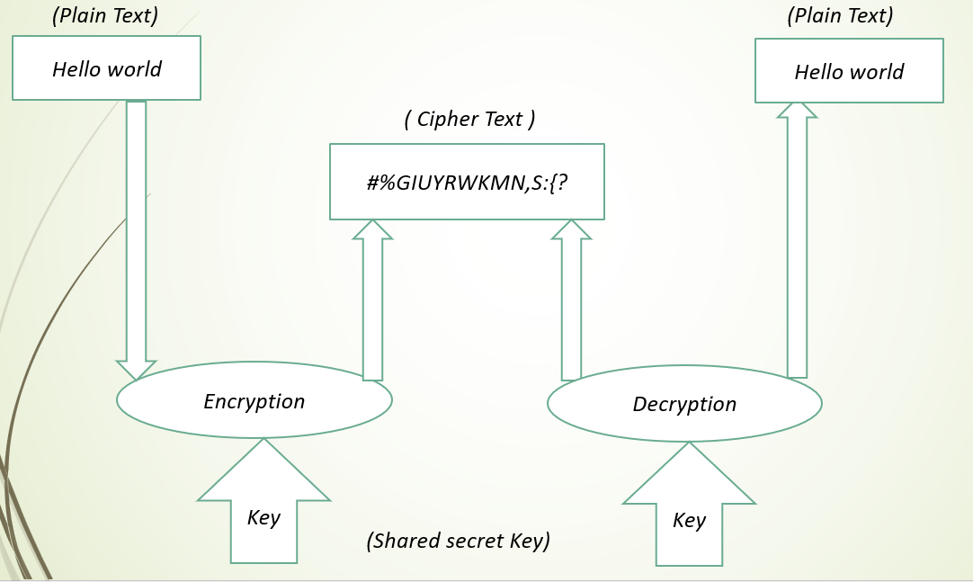
Working
The application will take the file location as input and return the encrypted file using some cryptographic algorithms
Then the decryption key for the file is sent to the mail of the given user
The application also take care in protecting the standards used in ciphering the text, and should manage the abstraction of principles applied from time to time

Slide 8
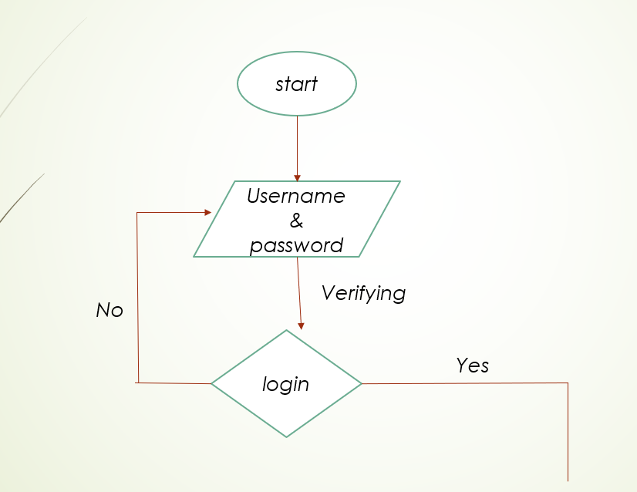
Data

Slide 9
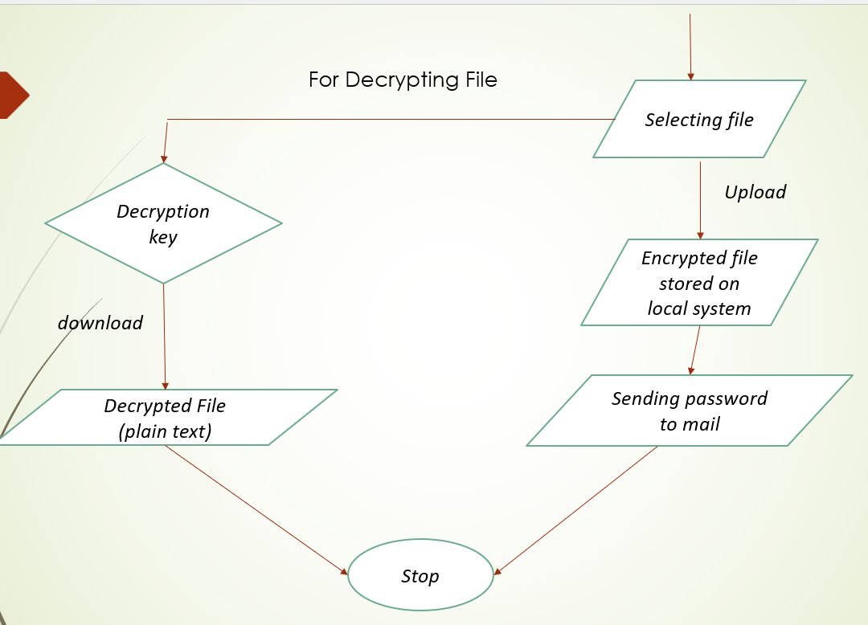
Data

Slide 10
Requirements
Software Requirements
Operating System : Windows 7
Programming Language : Java 1.8
Api : Mail Api
Hardware Requirements
Processor : Intel i3
Hard Disk : 20GB or above
Ram : 1 GB or above

Slide 11
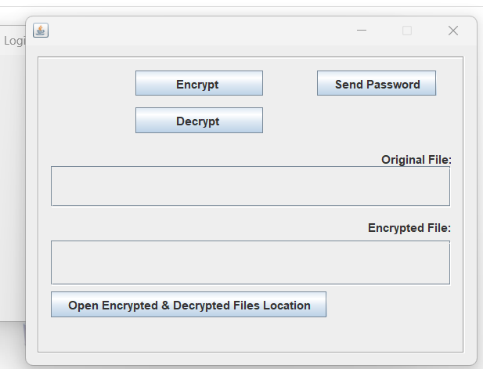
Dataset Output

Slide 12
Conclusion
We have contributed in the designing and development of a user space cryptographic file system. We have balanced the design goals like security, performance convenient and undependability of the system. We have achieved the high security by including the support of the Data Encryption Standard (DES). The performance is achieved with the help of on-demand computing concept which is that we are going to encrypt all files. It saves the performance overhead of the system. The system is very convenient to the users. And the in dependability is achieved with the help of the java technology which is highly portable. So the complete system is a highly independent of the configuration.

Slide 13


